Slide 1
Classification of Gaze Fixations by Area of Interest
Swapnil Vekhande

Slide 2
Introduction
Eye tracking systems have proven invaluable to studying human computer interaction with visual displays
They typically come with the caveat of requiring labor-intensive manual annotation.
Thus automatic extraction of relevant temporal segments of eye tracking data and classify gaze fixations by areas of interest using data mining or machine learning techniques is the goal of this project

Slide 3
PROBLEM STATEMENT
The issue of unreliable tracking typically arises from the method of eye tracking itself, or poor calibration of the eye tracking system.
While we can not solve the issue of unreliable technology without producing a completely new method of tracking, the issue of automatic classification features simply being unavailable can be solved with proper data analysis techniques.
Human Factors specialist in the Industrial System Engineering department were consulted for their expert inputs related to the domain.

Slide 4
Data Description
The data for this project is exported from BeGaze eye tracking software as a CSV where each data point represents an eye tracking event.
Eye tracking events are primarily classified within the dataset by behavior (i.e., blinks, saccades, or fixations). These classifications determine what quantitative data is available for the event (e.g., blink events do not report pupil size).

Slide 5
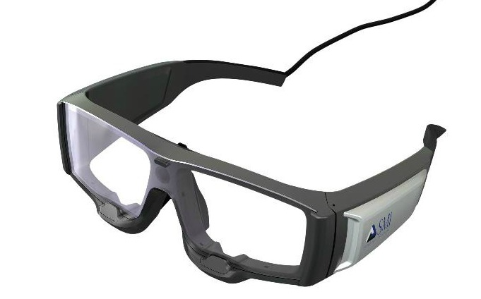
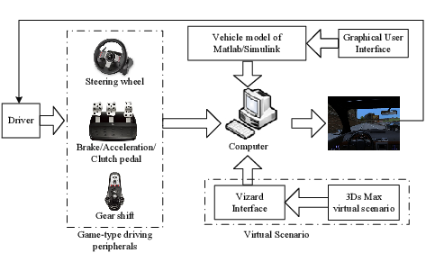
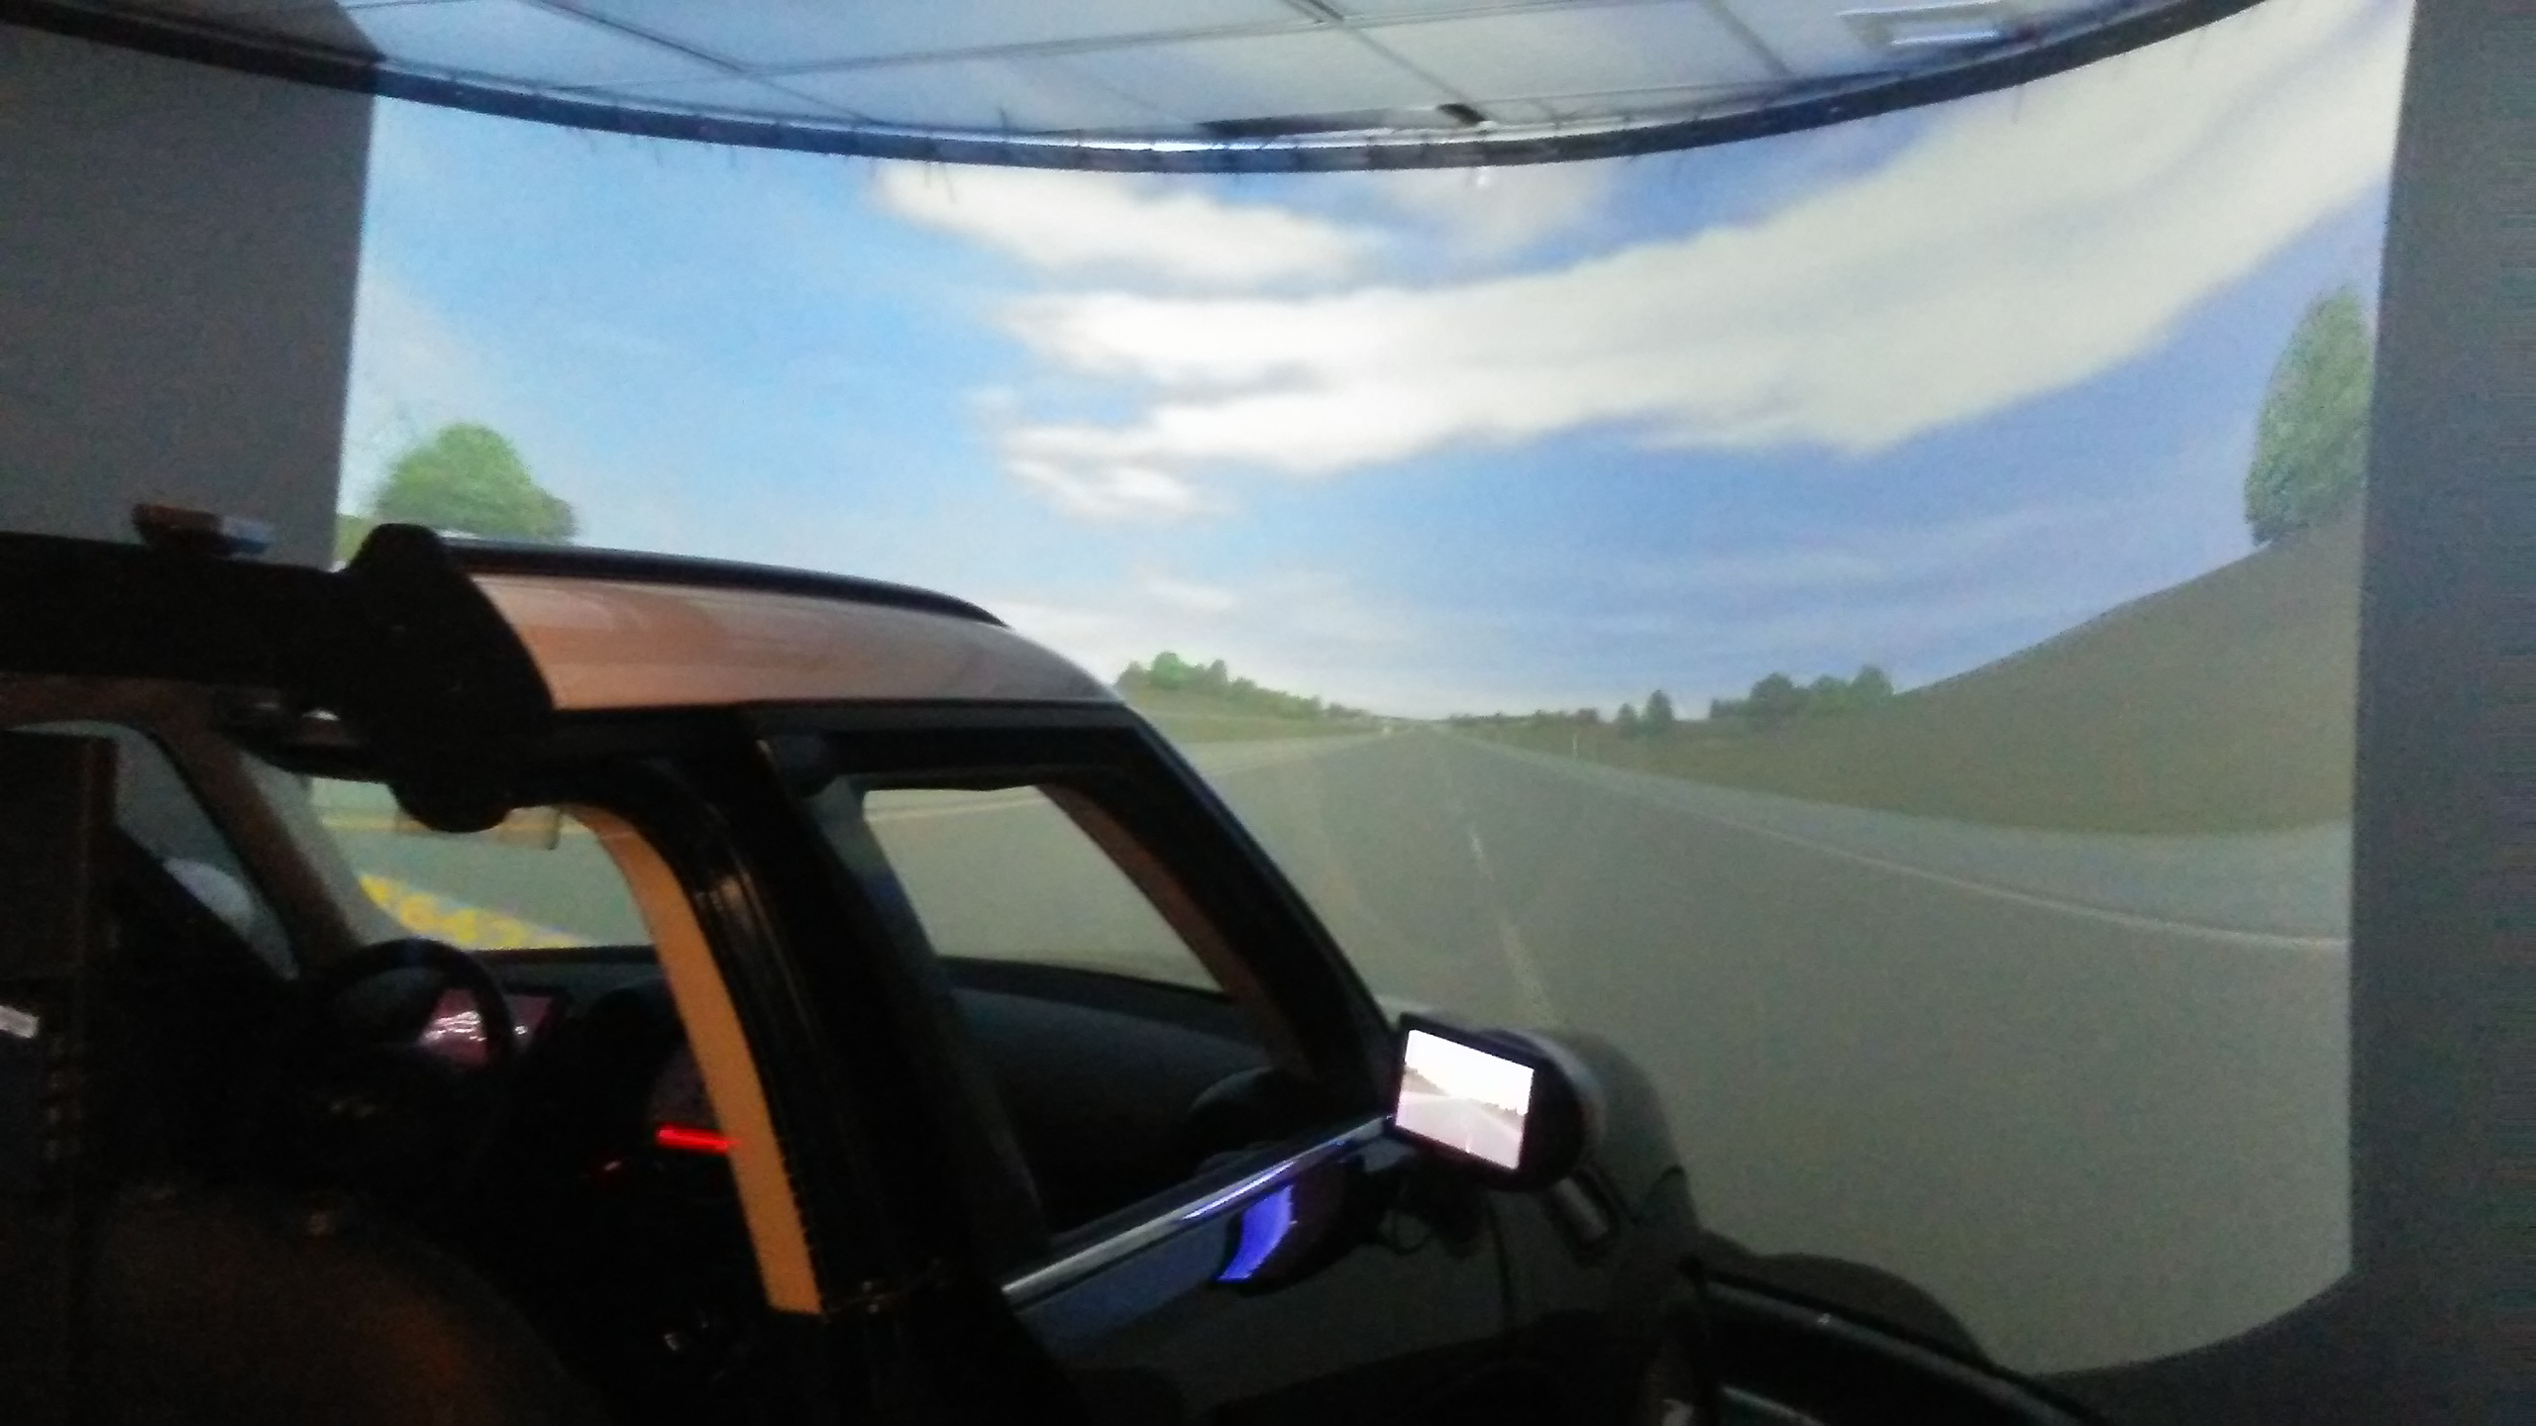
The System

Slide 6
DATA PRE-PROCESSING
First we remove the Fish-Eye distortions from the data.
Load the eye tracking data
Create a panorama by stitching together images.
Calibrate the camera
Homographic Projection of the data onto the 3D planeto account for the difference in perspective. Internally it uses RANSAC algorithm for matching
, data was normalized and reshaped

Slide 7
DATA EXPLORATION

Slide 8
Model Building
First Scale Invariant Features are extracted from the video
They are fed to the matcher

Slide 9
REAL-WORLD INSIGHTS
All application area of Human Computer Interaction will be impacted by the study of Region of Human Interest.
human factors research like drowsy driver dedtection will benefit by alleviating its primary bottleneck of manual annotation
automated approach to data preparation by similarly alleviating bottlenecks associated with research areas such as mental health and consumer experience.

